Slide 1
AquaSense
Water Supply Network Monitoring System

Slide 2
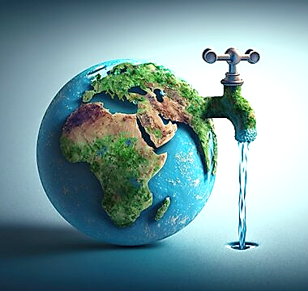
Water Supply Challenges
Insufficient raw water
Poor quality surface water
Inequitable distribution
Wastage and Economic Impact
3% safe water
40% estimated loss in distribution
66% people may face shortage in near future
Smart Water Management Solutions
Real time monitoring
Consumption measurement
Dynamic regulation
Leakage control
INTRODUCTION

Slide 3
OBJECTIVES
Transparency
Improve the transparency of all the processes in the water sully chain.
Immediate response
Identify or even predict issues and respond to minimize the damage.
Automation & optimized use of human resources
Partially or fully automate life cycle of providing water to consumers.
Sustainability
Technologies are no longer a source of savings and higher efficiency only, but the means to reach different environmental goals.

Slide 4
Methodology
Conceptualization and Planning
Hardware and Software Setup
Data Collection and Processing
Model Development and Integration
User Interface Design
Integration of Features
Testing and Debugging
User Feedback and Iteration
Finalization and Documentation

Slide 5
Technology Stack
Fa
R
P
FastAPI
React
PostgreSQL
A modern Python web framework, renowned for its high performance, simplicity, and automatic interactive API documentation, to streamline development and enhance the scalability
A popular JavaScript library for building dynamic user interfaces, offering a component-based architecture and efficient rendering.
A powerful open-source relational database management system, recognized for its scalability, reliability, and advanced features.

Slide 6
Features
1
2
3
Real-time Monitoring
GIS Integration
Analytical Insights
4
5
6
7
Grievance Redressal
Community Engagement
Alerts
Notifications
Usage Tracking
Automatic Billing
Accessibility
Scalability
Compatibility
Security
Privacy
and much more ….

Slide 7
Benefits
Efficient Usage
Improved Quality
Enhanced Efficiency
Leakage Control
Consumption Monitoring
Transparency
Immediate Response
Automation & Optimization
Cost Savings
Sustainability Goals

Slide 8
FUTURE SCOPE
01
02
03
04
Data Expansion
Integration of AI & ML
IoT Integration
Cloud Scalability

Slide 9
THANK YOU

